Slide 1
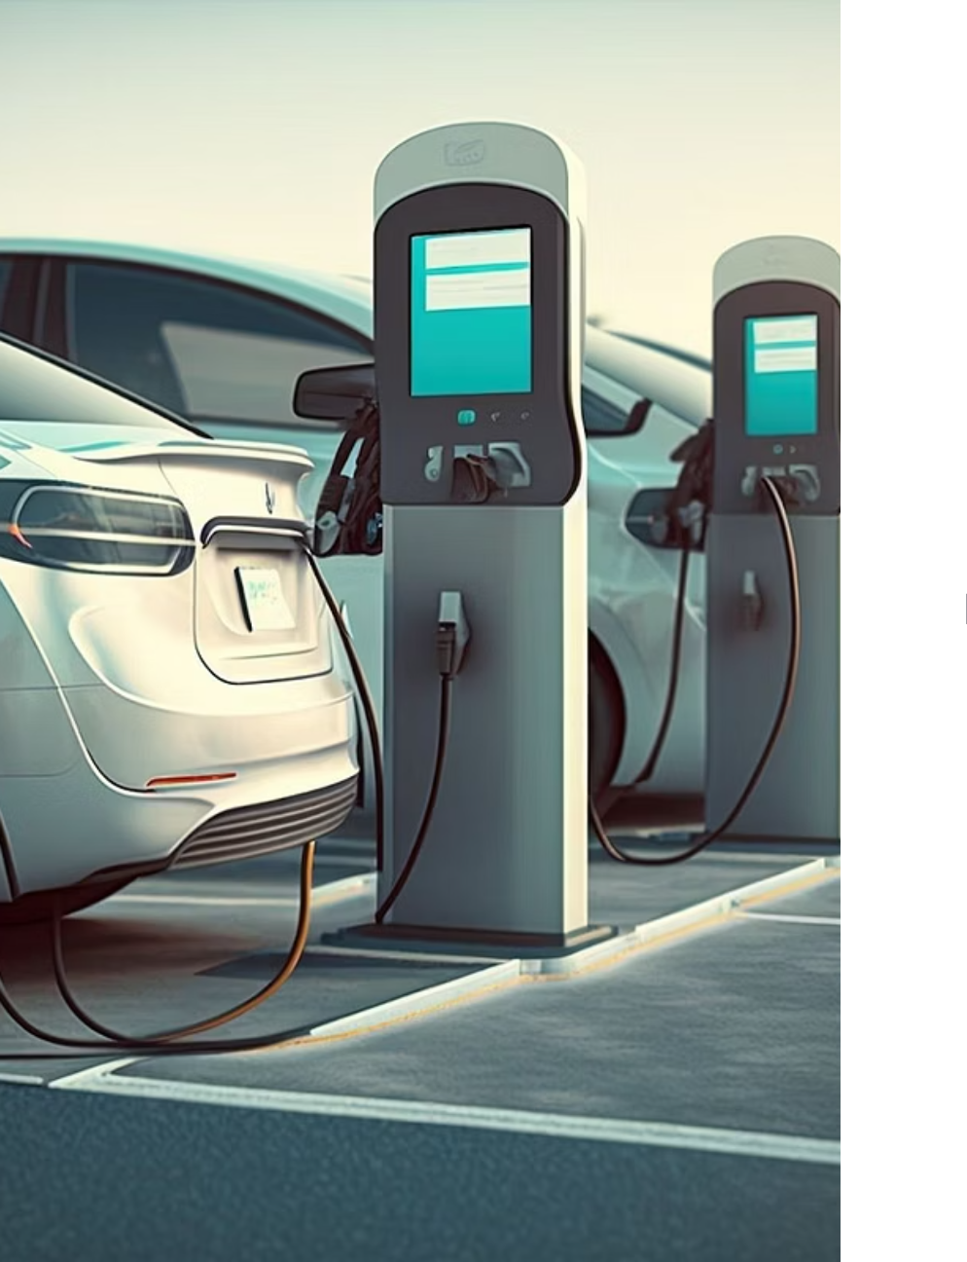
EV Charging System
DAMG6210-Group2
Devanshu Chicholikar 002810986
Saurabh Kashyap 002309182
Joseph Alex Chakola 002824177 Xingxing Xiao 002893927

Slide 2
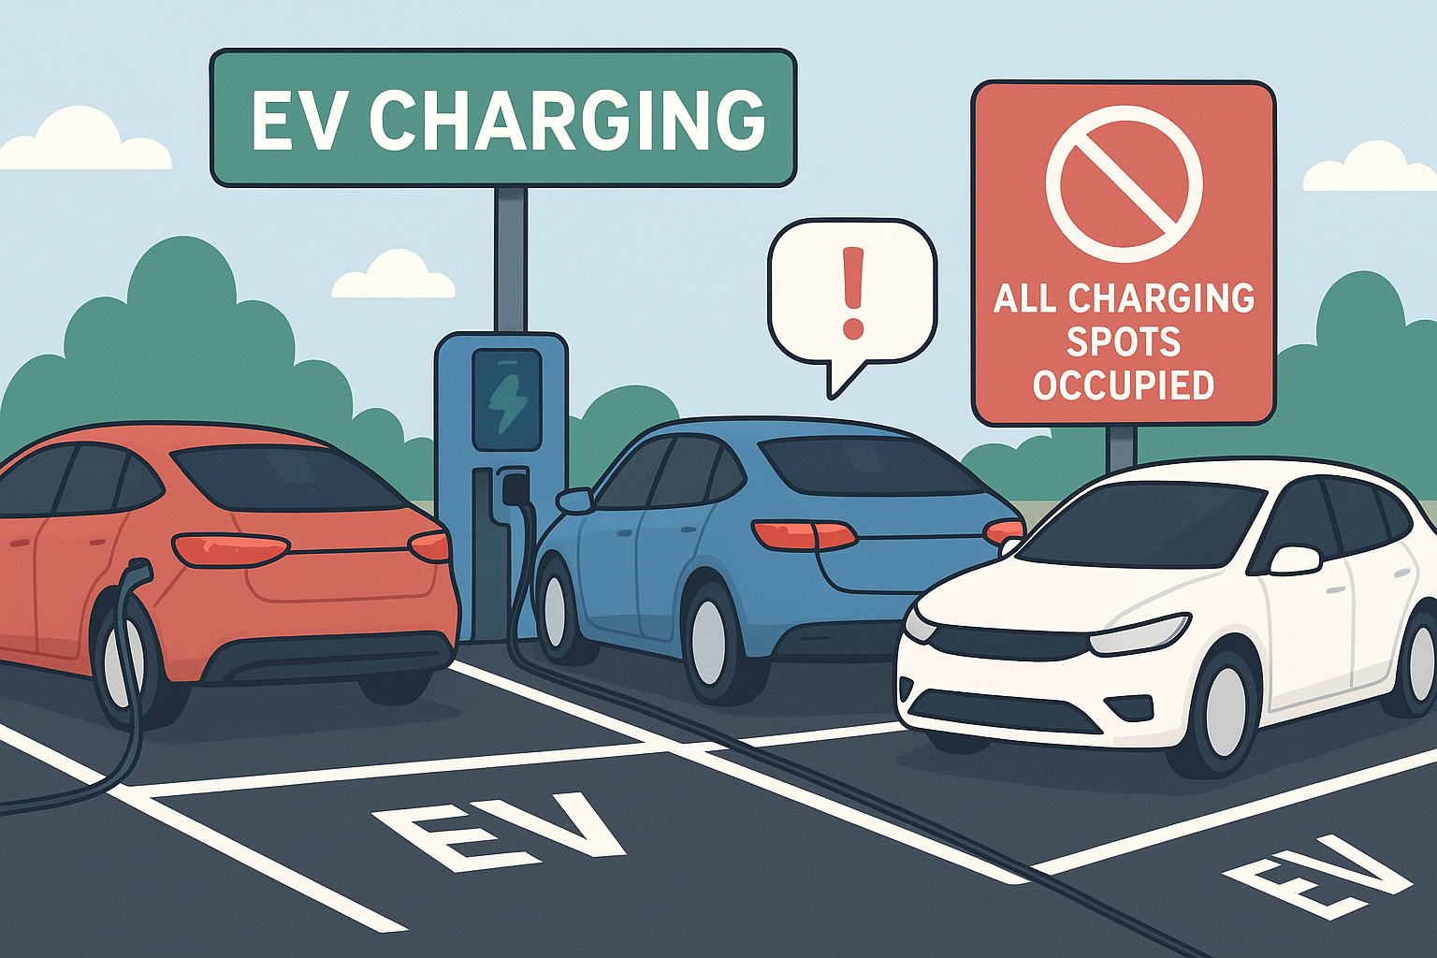
EV Charging System Goal
Pain Points:
When EV driver drive to charging stations, only fund all spots occupied.
No way to reserve a charger in advance,
No clear pricing information.
No system notify them when charging is complete.
Goal: to achieve Operational Excellence and Optimized Profitability by transforming raw transactional data into actionable business intelligence.
Operational Efficiency
Financial Integrity
Informed Strategy
Supporting Technical Goals:
Data Reliability
Scalability & Performance
Compliance & Security
Notes:
The electric vehicle market is growing rapidly, but charging infrastructure hasn't kept up. EV drivers today face a frustrating situation where they drive to charging
stations on
ly to find all spots occupied.
There's no way to reserve a charger in advance,
no clear pricing information,
and no system to notify them when charging is complete.
For station operators, the problem is just as bad. They deal with no-shows that waste capacity, cars that stay plugged in long after charging finishes, and manual tracking of usage and billing.
We're designing a database to solve these problems. Think of it like a reservation system for charging stations, similar to how OpenTable works for restaurants or how
parking apps work for garage spots. Users can see available chargers, book them in advance, get notifications, and pay automatically. Station operators get better
utilization and automated billing.
Our team chose this problem because we're interested in sustainability and the practical challenges of EV adoption. As more people buy electric cars, efficient charging infrastructure becomes critical. A well-designed database can make the difference between a smooth experience and a frustrating one.
Data Reliability: To serve as a single source of truth by enforcing consistency and atomicity for critical transactions (sessions, invoices, payments) using stored procedures and transactions (TRY...CATCH).
Scalability & Performance: To support rapid querying for BI tools (like Tableau) using a Star/Snowflake Hybrid Schema and highly optimized non-clustered indexes.
Compliance & Security: To protect Personally Identifiable Information (PII) and sensitive financial data (card numbers) via mandatory Column-Level Encryption.

Slide 3
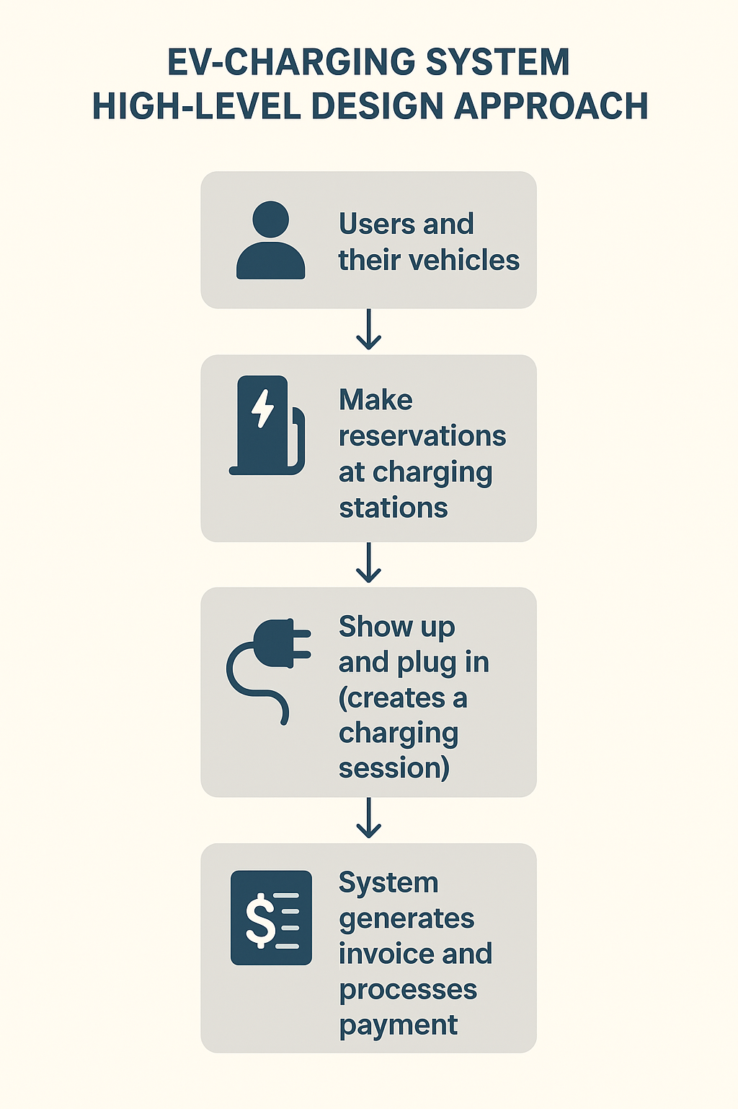
High-level Design & Approach
Users and their vehicles
↓
Make reservations at charging stations
↓
Show up and plug in (creates a charging session)
↓
System generates invoice and processes payment
↓
Operators monitor stations and handle maintenance

Slide 4
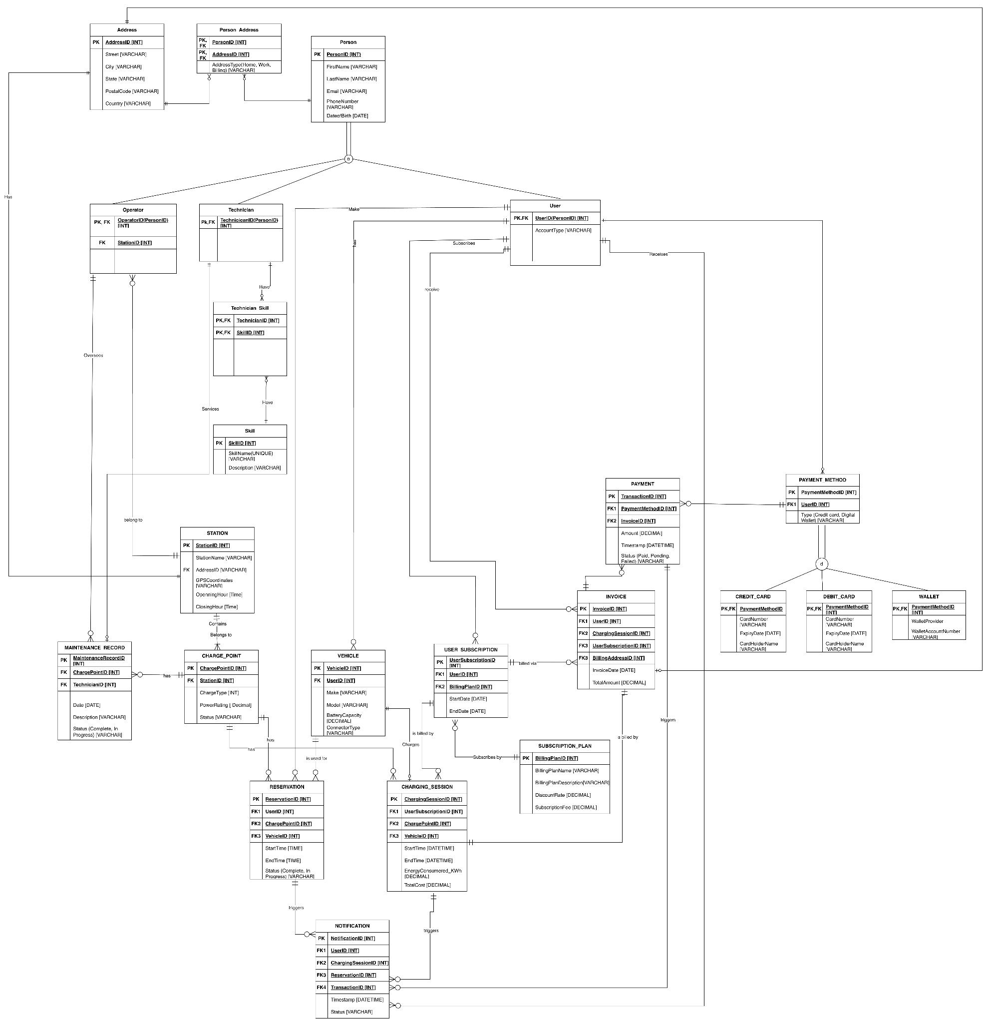
Finalized ERD
P4 ERD Total table Number: 23
People: user, operator, technician
Charging_session: station
Operate: reservation, charging, payment
Payment Method: Credit_Card, Debit_Card, Wallet
Notification:

Slide 5
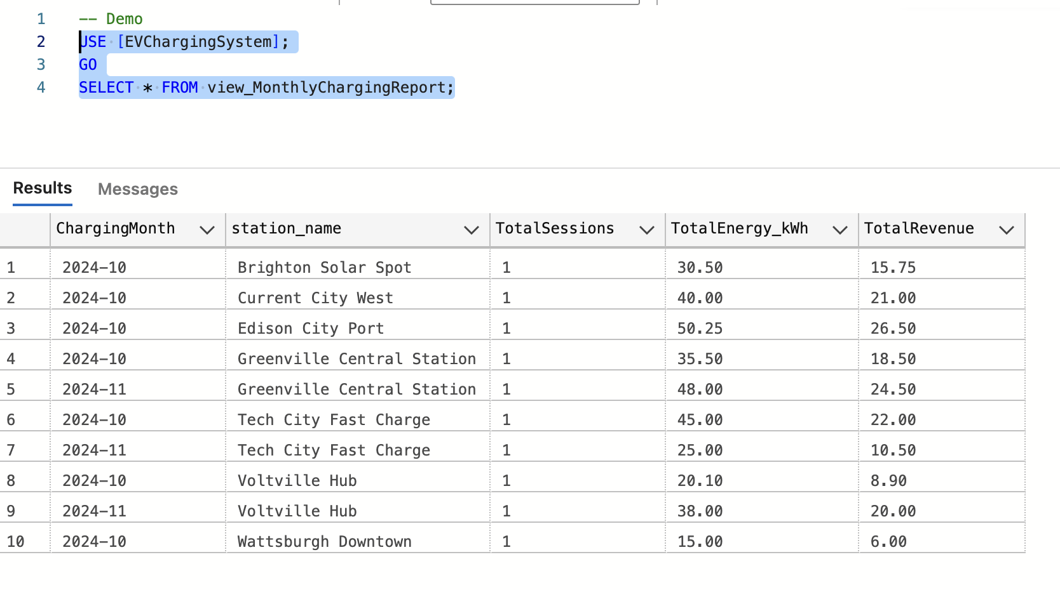
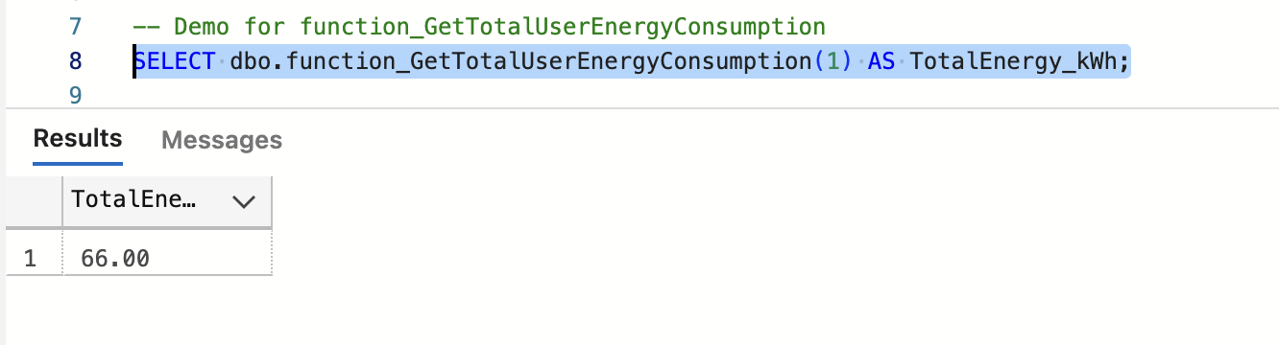
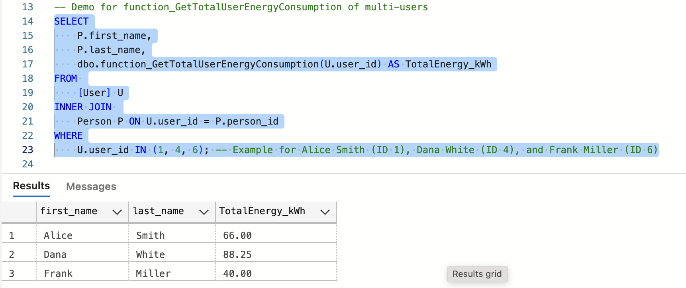
Implementation: Data Insights (Views)
View/Function:
Show output from view_MonthlyChargingReport
demonstrate the function function_GetTotalUserEnergyConsumption.
single-user
Multi-user

Slide 6
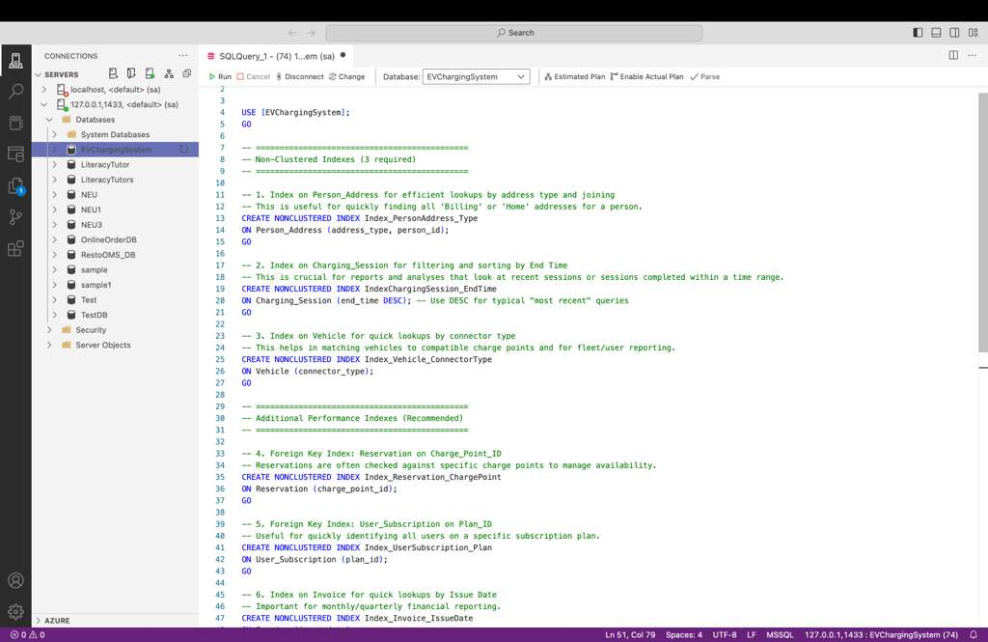
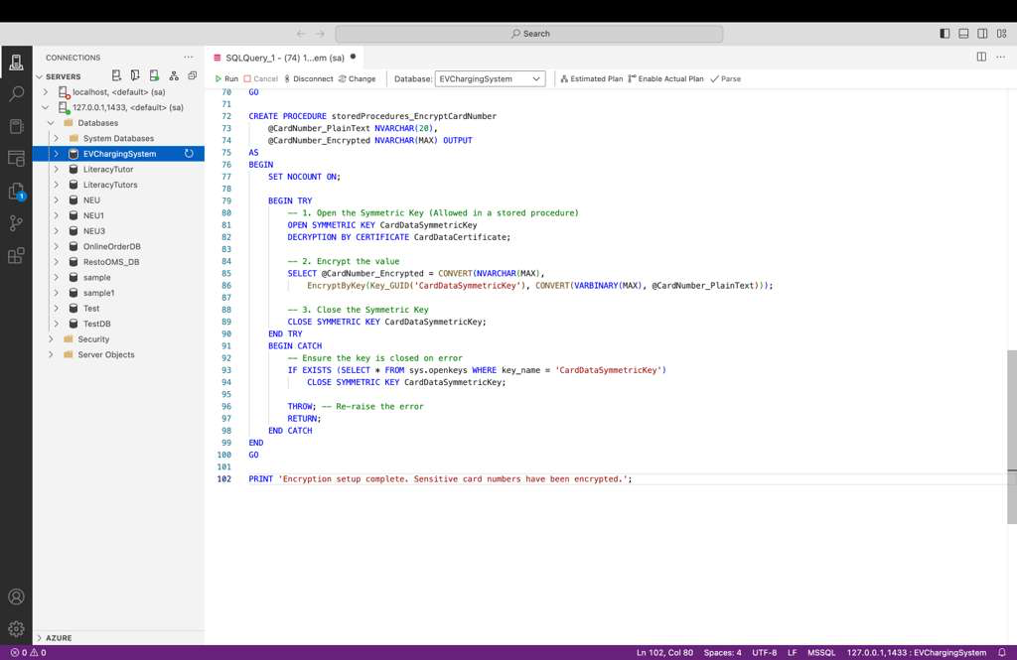
INDEXING
ENCRYPTION
Nonclustered Indexes for Performance Improvement
Data Encryption for Card Information

Slide 7
Implementation - Key artifacts
Stored Procedure
Security
storedProcedures_ProcessChargingSession
storedProcedures_UpdateChargePointStatus
storedProcedures_AssignTechnicianToMaintenance
SETUP: Database Master Key
SETUP: Certificate
SETUP: Symmetric Key
ENCRYPTION: Encrypt Existing Data
Trigger
Indexes
trigger_UpdateReservationOnSessionInsert
Index_PersonAddress_Type
IndexChargingSession_EndTime
Notes:
-- =============================================
-- 1. storedProcedures_ProcessChargingSession
-- Records a new charging session, updates charge point status, and creates an invoice.
-- Input: All session and invoice details.
-- Output: @NewSessionId (INT), @NewInvoiceId (INT).
-- =============================================
-- =============================================
-- 2. storedProcedures_UpdateChargePointStatus
-- Updates the status of a specific charge point.
-- Input: @ChargePointId (INT), @NewStatus (NVARCHAR).
-- Output: None.
-- =============================================
-- =============================================
-- 3. storedProcedures_AssignTechnicianToMaintenance
-- Assigns a technician to a maintenance record and sets the status to 'In Progress'.
-- Input: @RecordId (INT), @TechnicianId (INT).
-- Output: None.
-- =============================================

Slide 8
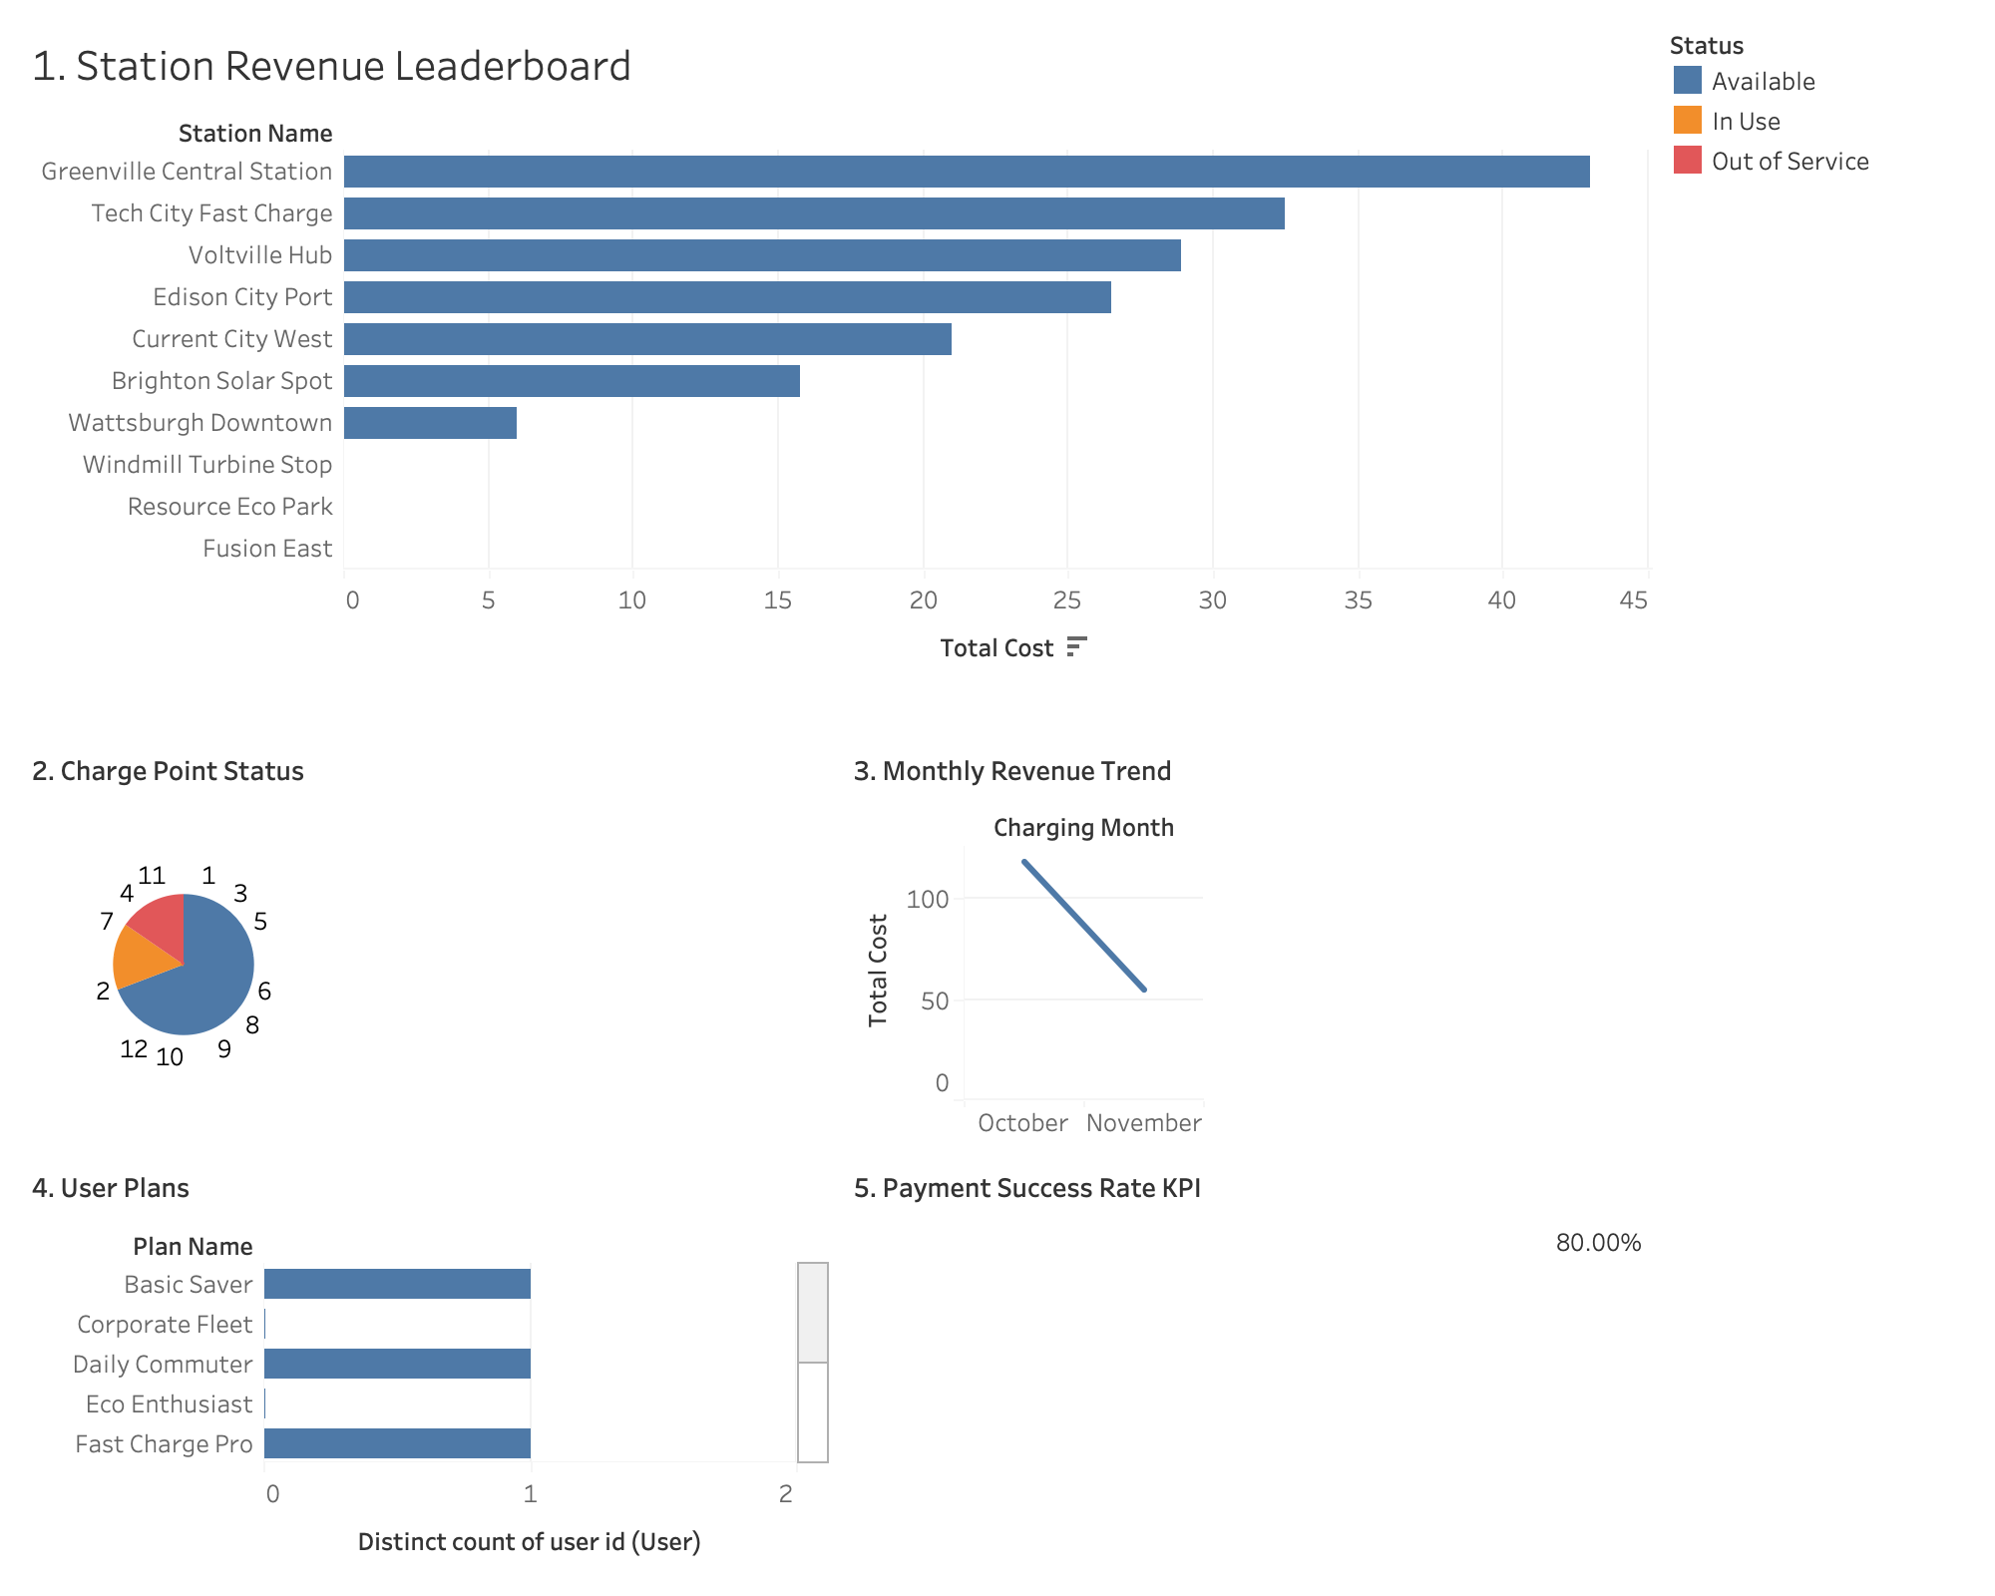
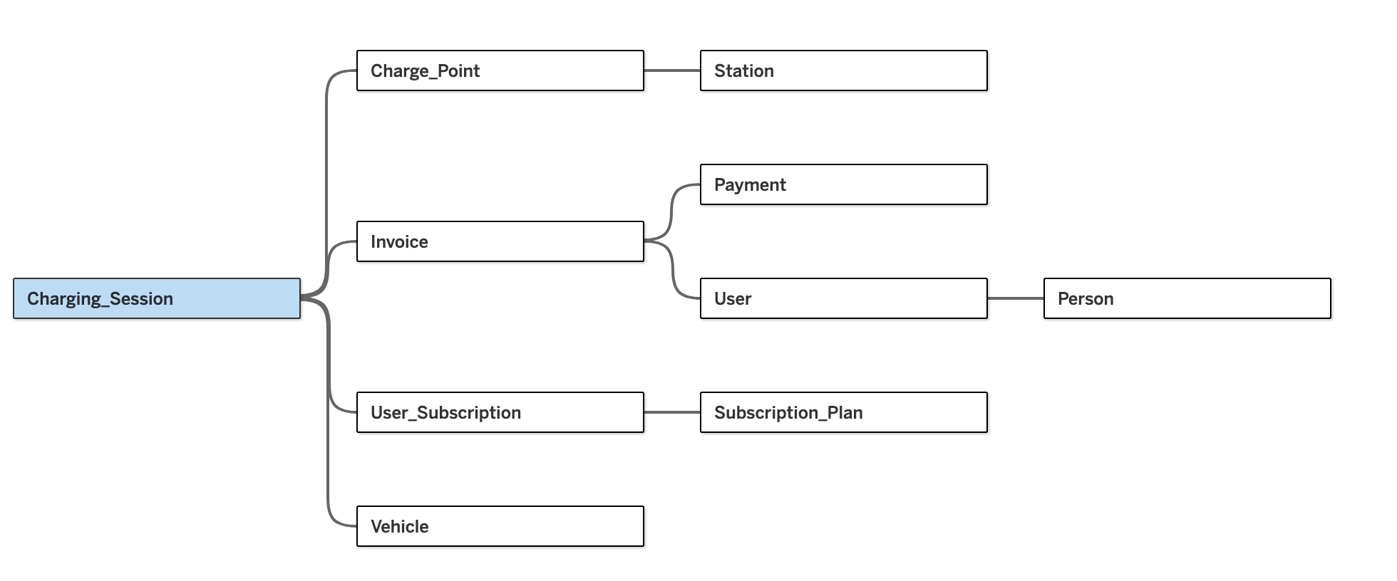
Tableau Dashboard Snapshot
Data Source
Dashboard
Two critical insights: Revenue Instability The Monthly Revenue Trend chart shows a sharp drop from October to November.
Critical Financial Leakage The Payment Success Rate KPI shows only 80.00% transaction reliability.
Three key areas: Operations, Revenue Trends, and Financial Health.
Notes:
Two most critical insights
1. The low Payment Success Rate (80.00%) as a critical risk.
2. The Station Revenue Leaderboard confirming Greenville Central's dominance.
Using Tableau Desktop, we created an interactive dashboard focusing on three key areas: Operations, Revenue Trends, and Financial Health. We will highlight two critical findings:" | | | "Finding 1: Revenue Instability: The Monthly Revenue Trend chart shows a sharp drop from October to November, signaling an urgent need for root cause analysis." | | | "Finding 2: Critical Financial Leakage: The Payment Success Rate KPI shows only 80.00% transaction reliability. This is an unacceptable level of financial leakage that must be immediately addressed."

Slide 9
Conclusion & Next Steps
Conclusion:
The EV Charging System project confirms the successful establishment of a robust, secure, and analytically capable database foundation
Next Steps:
Financial Security and Leakage Prevention(80% Payment Success Rate issue)
Operational Improvement and Customer Experience
Business Strategy and Investment
Notes:
a software bug is something which is not working as designed.
A software bug is an error, flaw, failure, or fault that produces an incorrect or unexpected result.
While Grace hopper (she) was working on a Mark II computer at Harvard University, her associates discovered a moth stuck in a relay that impeded operation and wrote in a log book "First actual case of a bug being found".
What does this kind of bug have to do with software?

Slide 10
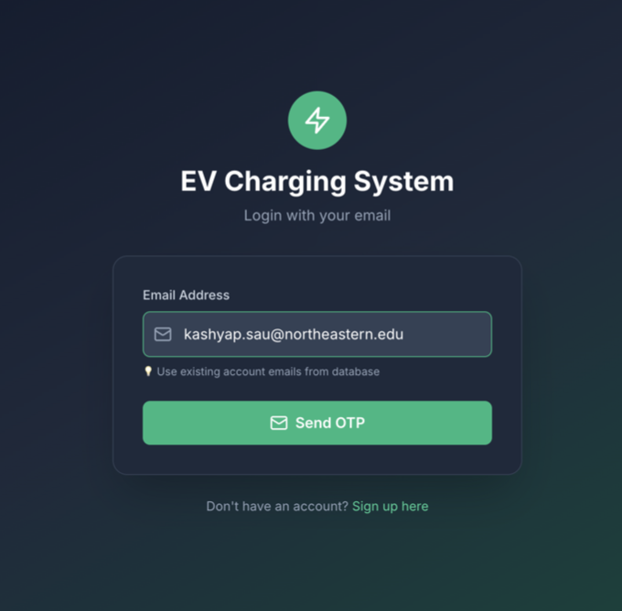
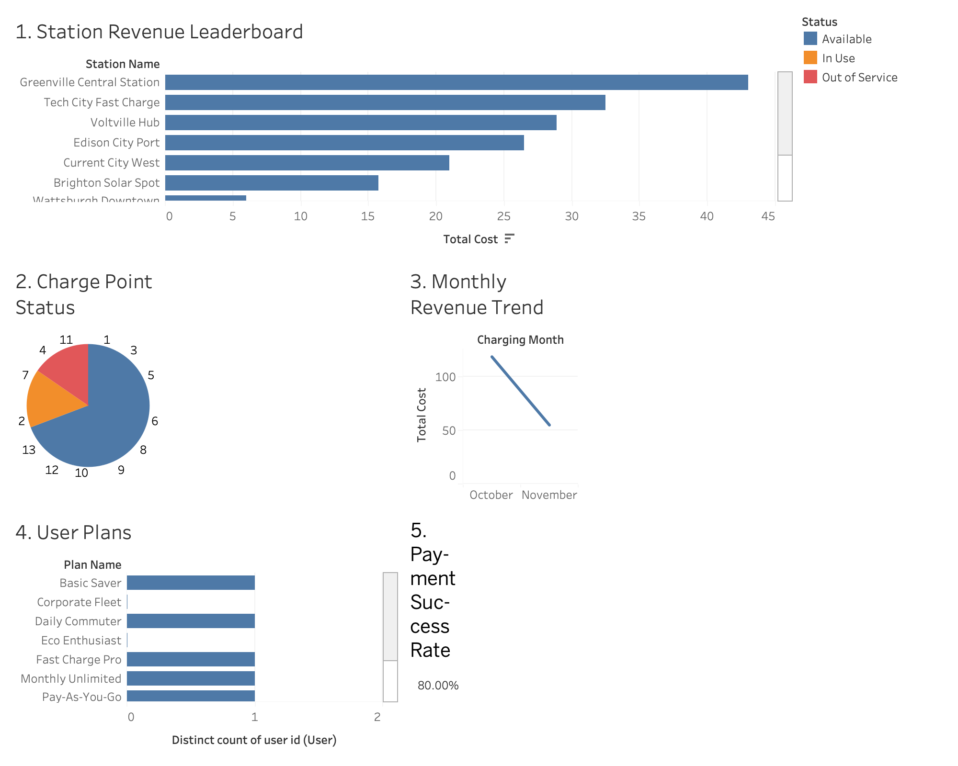
Live Demo
Dashboard from Tableau
GUI
SQL Server
Try Run a SELECT query on the Credit_Card table to prove the data is encrypted (using EncryptByKey)
Notes:
The demo should be rapid and clearly show the link between the raw database and the analytics layer.
SQL Server (30 seconds): Briefly show Azure Data Studio/SQL Server.
Action: Run a SELECT query on the Credit_Card table to prove the data is encrypted (using EncryptByKey).
Statement: "We confirm that sensitive card data is stored securely using Column-Level Encryption."
Tableau Interactivity (90 seconds): Switch to your Tableau Dashboard.
Action 1 (Problem Identification): Point to the Payment Success Rate (80.00%) KPI and the Monthly Revenue Trend chart. State: "The database revealed a critical 20% payment failure rate and a sharp revenue drop in November."
Action 2 (Drill-Down): Click the bar for Greenville Central on the Station Revenue Leaderboard. The other charts should filter instantly.
Statement: "Our analytics layer is operational. By clicking on our top revenue earner, Greenville Central, we can instantly drill down to verify its unique contribution and operational status."
Conclusion: "The system is robust, secure, and provides actionable insights for immediate decision-making."

Slide 11

Q & A
Thank you

